Slide 1
Fresh Grads – Group Project
Vehicle loan Application

Slide 2
Problem Statement

Slide 3
Road Map
Application will be developed in following -
Spring Boot + Rest Controller + JPA with Hibernate

Slide 4
Plan
Design
Generate the skeleton as per class design provided
2.Implement the case study in incremental manner

Slide 5
Account
Module
Modules
adminModule
login Module
Loan application Module
Userdetails Module
User register Module

Slide 6
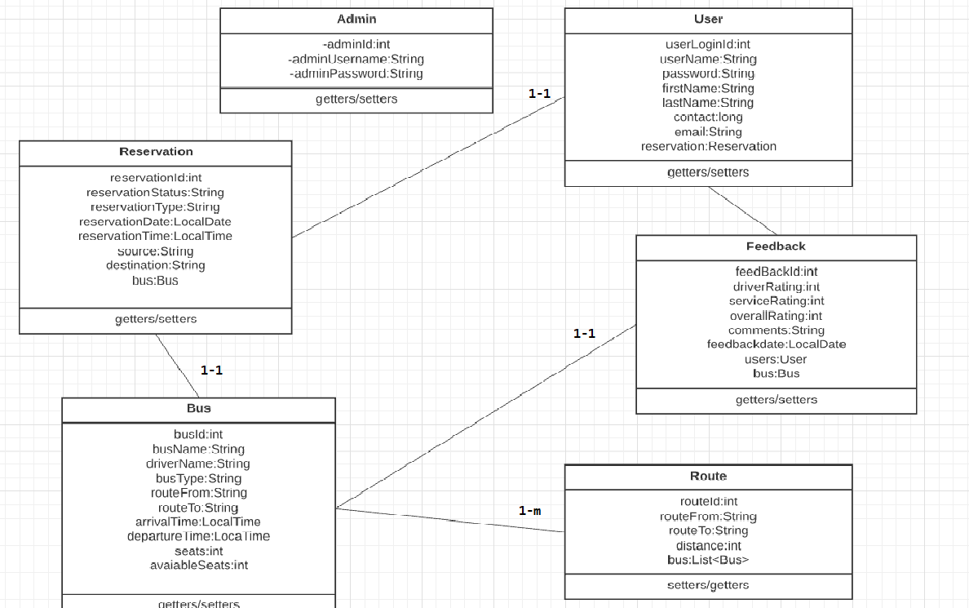
Class Design
POJO Classes:

Slide 7
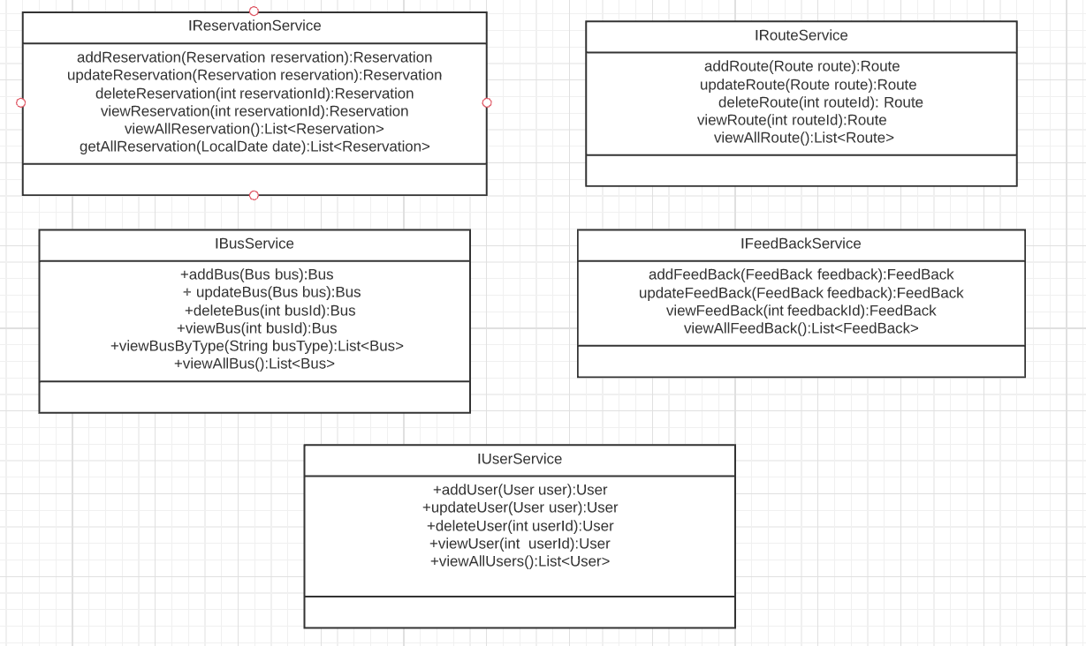
Class Design
Service Interface:

Slide 8
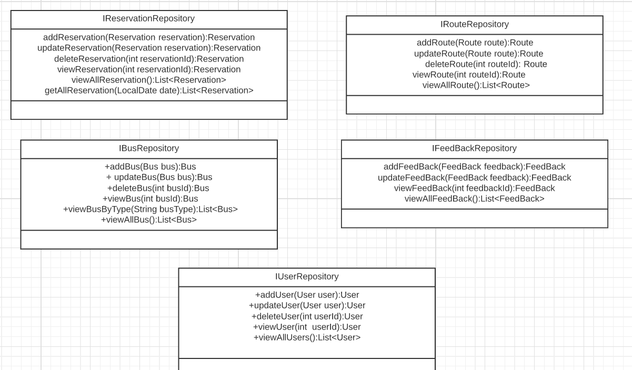
Class Design
Repository:

Slide 9




Questions

